Slide 1

Seasoned With Care:
How Empathy Transforms Foodservice
Image Source:
Shutterstock
By Kathryn Fenner, Senior Principal
In today's competitive foodservice landscape in which consumer traffic is slumping but desire to enjoy foodservice remains, connecting with consumers requires more than food quality and service speed. Leading commercial and noncommercial operators are discovering that empathy—the ability to understand and respond to the kind of day a customer is having—has become a critical differentiator in creating meaningful dining experiences. This whitepaper explores how empathy-driven operations are transforming the foodservice industry and how manufacturers can support these efforts.
This report and its contents are approved for republishing and sharing in part or in full with appropriate citation and sourcing to Technomic

Slide 2
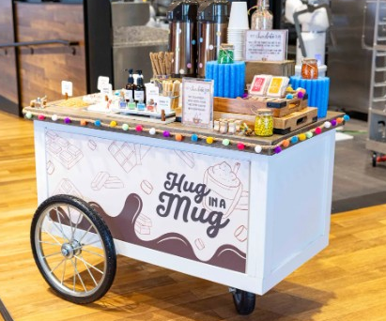
What Empathy Means in the Foodservice Space
  Empathy in foodservice operations means recognizing that every customer or guest arrives with a unique emotional state, set of needs and expectations shaped by their daily experiences. For example, a hospital visitor facing a family health crisis requires a fundamentally different experience than a healthcare employee seeking a mid-shift respite from work pressures. A homesick college student has different needs than the group of friends looking to make someone’s birthday extra special.
  Being able to respond to those consumer needs through the foodservice offering (including service and menu) is critical to providing consumer value away from home. It’s what transforms something transactional into something memorable.
Empathy in Action
  Noncommercial operators are leading the way in prioritizing operational empathy. It makes sense, given the critical role these segments play in consumers lives. Noncommercial foodservice operations are embedded in the places where people spend the majority of their time—schools, workplaces and healthcare facilities. Noncommercial foodservice makes nutritious food accessible when and where people need it most. But they have an opportunity to provide more than simple nutrition. And the practice is growing in noncommercial. In fact, 33% of accounts operated by a foodservice management firm (FSM) and 34% of self-operated accounts plan to focus on training for friendly service and connection in the coming year.
  Let’s look at how empathy plays out in specific noncommercial segments.
  HEALTHCARE: COMFORT IN CRISIS
  Healthcare foodservice represents one of the most empathy-critical environments. Patients, families and staff all experience heightened emotional states—anxiety, grief, exhaustion, relief—that profoundly impact their foodservice needs.
  Morrison Healthcare, a Compass Group company, has pioneered approaches to comforting all types of guests through empathetic service delivery. Their programs recognize that:
  Patients may be experiencing pain, medication side effects or emotional distress that affects appetite and food preferences
  Family members often need quick, convenient options while maintaining vigils or managing crisis situations while others need a more extended break from a difficult situation
  Healthcare workers require efficient service that respects their limited break times while providing genuine nourishment and respite
  So, what does empathetic healthcare foodservice mean in this instance? It adapts to these realities through flexible meal timing, comfort food options and friendly service approaches that acknowledge the emotional weight of the healthcare environment.
  An example of this is Morrison’s themed snack and celebration carts, like the hot chocolate cart pictured below. The Hug in a Mug cart provides a moment of fun for pediatric patients going through a difficult time, allowing them to customize their own mug of hot chocolate with a variety of toppings
Empathy is about recognizing the human being behind every order, understanding their emotional state, anticipating their needs and creating moments that matter.
Image Source: Foodservice Director

Slide 3
  Education: Supporting Student Success
  In educational settings, empathy manifests differently across the academic calendar and student lifecycle. At the primary school level (K-12), it may be understanding a student's apprehension about trying an unfamiliar food, treating a food allergy as an opportunity for inclusion in the menu so a student doesn’t feel singled out or even recognizing and assisting with food insecurity where it exists.
  At colleges and universities, a first-year student navigating homesickness requires different support than a senior celebrating completion of final exams or a graduate student balancing coursework with family responsibilities.
  Noncommercial operators have found many ways to serve customers facing these varied scenarios.
  Operators create spaces and experiences that combat loneliness and build community. For example, Aramark Collegiate Hospitality partnered with Frank’s RedHot at the University of South Carolina to throw a tailgate party for students that included swag and a scavenger hunt to encourage interaction. And the dining halls featured three different Frank’s RedHot sauces, allowing students to personalize their food.
  Operators find ways to help students celebrate diversity. Chartwell’s hosted
  a Dia de los Muertos event with a special menu featuring traditional Mexican dishes at Texas State University to create emotional connections and enhance the student experience beyond basic nutrition.
  BUSINESS & INDUSTRY: FUELING PRODUCTIVITY AND WELL-BEING
  Corporate dining environments serve employees who are navigating diverse daily pressures, such as tight deadlines, challenging meetings, work-life balance struggles and varying energy levels throughout the day. Technomic’s 2025 Business & Industry Multi Client Study found that on-site employees see workplace foodservice as meeting multiple needs. The most common is a welcome break to recharge from work pressure, followed by a chance to treat themselves and a chance to fuel up with healthy food (see Exhibit 1).
  Operators must understand the needs of their customers to provide the service model and menu to support.
  Some examples could include:
  Morning service: Supporting employees starting their day, often needing quick, energizing options
  Midday breaks: Providing genuine respite that allows mental reset and social connection. This requires comfort food options for those who want to treat themselves, as well as healthy options for others
  Afternoon needs: Offering sustained energy options for the second half of the workday
  Special occasions: Facilitating team celebrations and milestone recognition
Exhibit 1: Key Roles of Workplace Foodservice
Base: 802 B&I consumers
Q: Which of the following statements best describe the role workplace foodservice plays for you?
Source: Technomic 2025 Business & Industry Multi Client Study

Slide 4
The Business Case for Empathy
  Many foodservice companies have identified empathy as a strategic priority, recognizing that connecting with guests in this way drives satisfaction and loyalty, as well as creating lasting value. And, as a side benefit, the cultural embedding of empathy and the training provided to staff also boosts employees’ sense of purpose and team morale, allowing them to feel part of something meaningful when they are empowered to make choices that have a real impact on guest satisfaction.
  The idea of empowering employees to improve customer service is not necessarily new to the hospitality industry. The Walt Disney Company, for example, has empowered the employees at its parks for decades to create happiness, trusting them to act independently to deliver magical moments, from something as simple as a free sweet treat to help a guest celebrate a birthday to replacing the balloon lost by an inconsolable child. Another example, The Ritz-Carlton Hotel Company implemented its famous customer service policy way back in 1983, when it began to allow any employee, from foodservice to housekeeping to front desk staff, to spend up to $2,000 per incident, per guest, to address a problem or create a memorable experience, without managerial approval. The policy was based on the ideas that luxury hospitality wasn't primarily about opulent spaces, but about making guests feel at home and ensuring their needs would be met without hesitation. The rule is still in place today.
  In the current foodservice environment, with increasing costs and shrinking operator margins, the temptation may be to cut back wherever possible. But longer term, the winners will be those who invest in their people and their customers’ experiences.
  Let’s consider some examples of restaurant chains that have successfully embedded empathy into their core mission statements and operational culture. Each of these companies has outpaced the average growth of 3.0% achieved by the Top 500 chains in 2025.
  The first example is Chick-fil-A, with a stated mission to be “America's best quick-service restaurant at winning and keeping customers.“ To accomplish this, employees are trained to approach customers with warm welcomes and lighthearted conversations, so each person feels that their presence is valued. Team members are also encouraged to anticipate
  needs—from bringing extra napkins to a family with children to walking orders to cars during bad weather. These efforts have paid off. In Technomic Ignite Consumer surveys, Chick-fil-A has received a top-box rating for pleasant, friendly service from 66% of guests, much higher than the average of 48% achieved by its competitive set.
  The next example, also a quick-service chain, is In-N-Out, which fully empowers its employees to accommodate the chain’s extensive "secret menu" and any custom orders, so that guests can enjoy the food exactly to their own personal taste. Further, every employee is authorized to refuse to serve food that doesn’t meet quality standards, and team members can remake orders or address concerns without seeking permission. As a result, 71% of their guests give them a top-box rating for pleasant, friendly service compared to a 52% competitor average.
  The chart below demonstrates that these chains are rewarded for their stellar customer service with strong sales growth (see Exhibit 2).
EXHIBIT 2: Chains showing empathy
Chain With Empathy Embedded in Policy | 2025 Chain Sales Growth | Top 500 Chain Avg. Sales Growth
Chick-fil-A | 5.2% | 3.0%
In-n-Out | 9.6% | 3.0%
*Source: Technomic 2026 Top 500 Chain Restaurant Report

Slide 5
  Noncommercial entities that build empathy into their strategic priorities are also realizing stronger growth. The top three foodservice management firms (FSMs) all have strong policies in place. As a result, FSM-managed accounts saw sales grow 7.6% (CAGR) between 2022 and 2025, compared to 4.0% growth at self-operated accounts during the same time period.*
Putting Empathy Into Practice
    1. Embed empathy into corporate culture
  Chick-fil-A built a culture around “my pleasure." Employees are trained to respond to customers’ “thanks” with "my pleasure" instead of "you're welcome," reinforcing that serving guests is a privilege, not a burden.
  Nordstrom, including its restaurants (Nordstrom Cafe, Bistro and eBar) is known for it’s one-rule handbook: "Use good judgment in all situations. There will be no additional rules.“ This radically simple approach to embedding empathy demonstrates trust in employees to make smart decisions based on customer needs rather than rigid policies. Admittedly, this approach may not work for everyone, but the basic premise should. Embedding empathy into your culture involves consideration for both employees and guests, as well as a belief that once your employees understand the importance of customer service, they can be trusted to deliver upon it.
  2. Ensure staff training accounts for empathy
  Training goes beyond traditional customer service training. Trainees must understand it requires proactive problem-solving and adaptive service delivery, adjusting interaction style, pace and offering based on the customers needs.
  Develop emotional intelligence and situational awareness, teaching staff to recognize emotional cues (verbal and nonverbal) and environmental context to inform their service approach.
  Practice active listening skills so employees can move beyond transactional exchanges to genuine understanding.
  3. Train for success by “doing” and not just “telling”
  Every corporate employee at Shake Shack works at one of the chain’s restaurants for at least three days, and leadership frequently visits units to understand the "anthropology" of what customers and employees experience. This ensures leaders making operational decisions have genuine empathy for both customer and employee experiences.
  Whether you are training operator executives or manufacturer employees who are designing portfolios and services, include cross-training or immersion exercises to ensure they truly understand the employee and guest experiences.
Manufacturers must cultivate empathy for both the foodservice operators they sell to and the guests those operators serve, making it a core part of the industry culture.

Slide 6


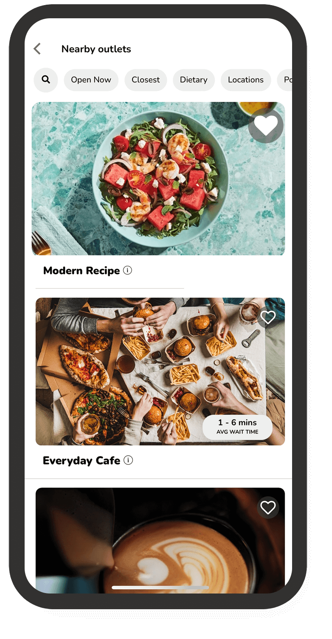
Role of Tech in Empathy
  Despite most consumers still preferring to speak with staff when ordering (see Exhibit 3), there is still a role for technology. Importantly, strategic integration of technology for transactional elements can free staff up to have more meaningful interactions.
  Examples include back-of-house tech that helps staff manage menus and ingredient replacements when shortages occur, as well as software that enables quick staff scheduling, so the manager can focus elsewhere. Front-of-house tech, including digital signage and smart phone apps, can supplement human interaction, while also providing detailed menu information for confident decision-making.
  Also, more sophisticated tech-enabled preference tracking through loyalty programs can be used by staff to create delightful, in-the-moment experiences.
  Sodexo developed its Everyday app, which now has more than 6 million users and keeps the needs of its guests top of mind. Key features include:
  Guests can select a pickup time that works for their schedule, choose delivery or view current in-store wait times, if they plan to visit and order in person
  Scan-and-go capabilities that streamline checkout
  Personalization that allows users to highlight allergens, identify healthy/vegan/vegetarian options, track loyalty programs and see the carbon impact of their menu choice
Image Source: Sodexo website
EXHIBIT 3: IMPORTANCE OF SPEAKING WITH RESTAURANT STAFF WHEN PLACING AN ORDER
71% of consumers say it’s at least moderately important to speak with restaurant staff when placing an order
Base: 1,000 consumers
Q: How important is it for you to have the option to speak with a restaurant employee when placing an order?
Source: Technomic Q1 2026 Consumer & Operator Outlook Report

Slide 7
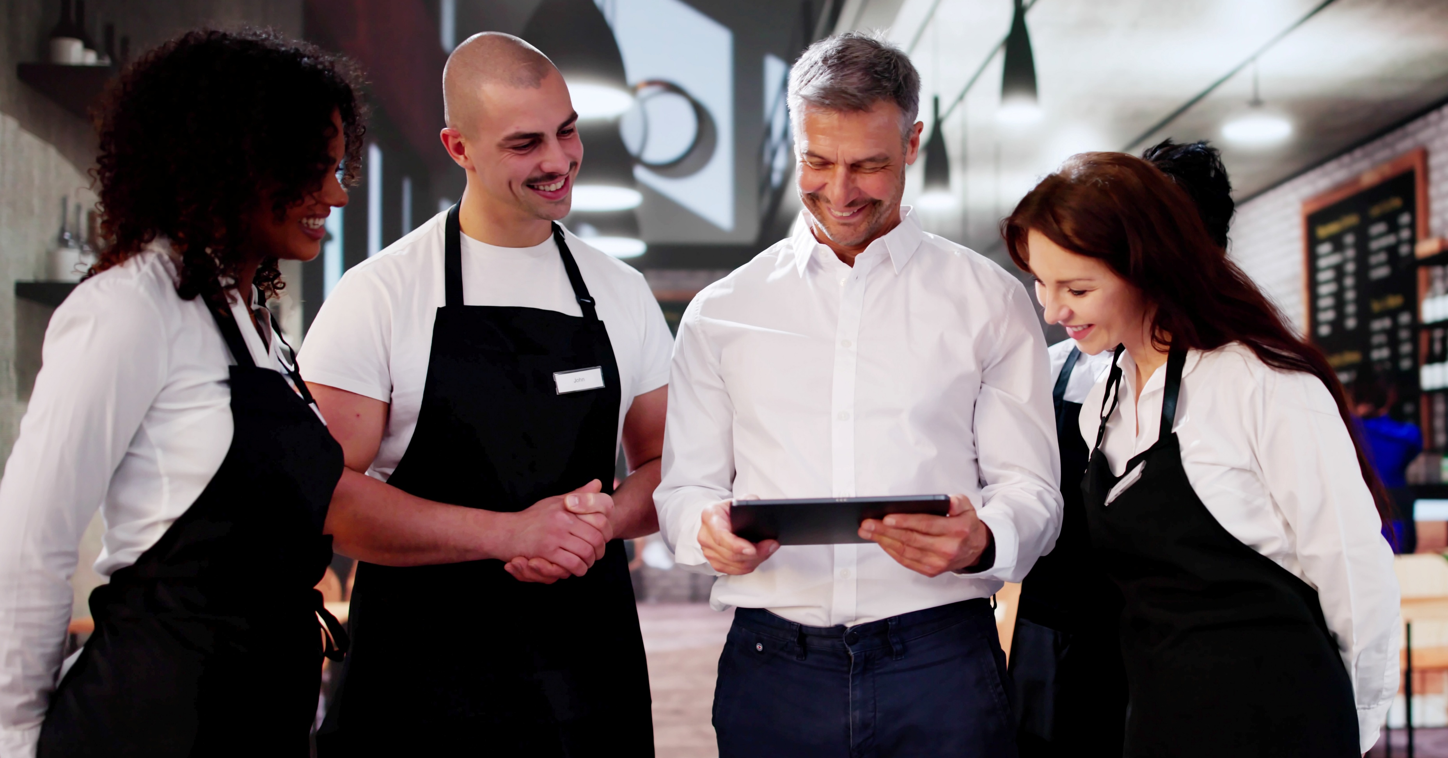
Conclusion
  The operators and manufacturers who master empathy-driven service delivery will capture the hearts and minds of their customers.
  To enable and enhance empathetic customer experiences:
  Build empathy into company culture and training
  Recommend products and applications by need state, whether it’s for someone looking for food that is fast and won’t weigh them down, someone who is looking for a quiet moment with comforting food, or a celebration featuring an unforgettable menu
  Build flexibility into products so operators can comply when customers want to customize; consider fun ways that staff could use your products to surprise or delight in a variety of circumstances
  Help support employee well-being, which will allow them to focus on providing the right offering to each customer
  Highlight menu items or ingredients that require less-complex preparations or design to reduce unpleasant, time-consuming tasks (e.g., chopping, slicing, opening difficult/heavy packaging, cleaning oily equipment, etc.)
  Provide ideas or opportunities for staff self-care and employee recognition
  Establish a system for obtaining qualitative and quantitative feedback so that successful, empathetic transactions are captured and you can assure customers’ needs are being met

